Slide 1
Wabash Capstone
Project Notes 09
By: John Danison

Slide 2
What Did I Say I Would Do This Week?
Continue to refine the noise readings in strain gauge
Begin creating schematics in Altium Designer

Slide 3
What I Have Done Over The Past Week
Rewrote firmware to better give data output.
Starting researching noise reduction strategies. See slide 4.
Updated current electrical schematics and began Altium Designer schematic design. See slide 5.
Wrote all documentation for electrical and software for Gate Report 04.

Slide 4
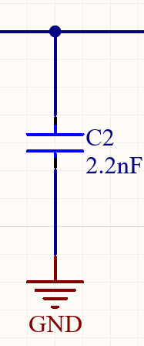
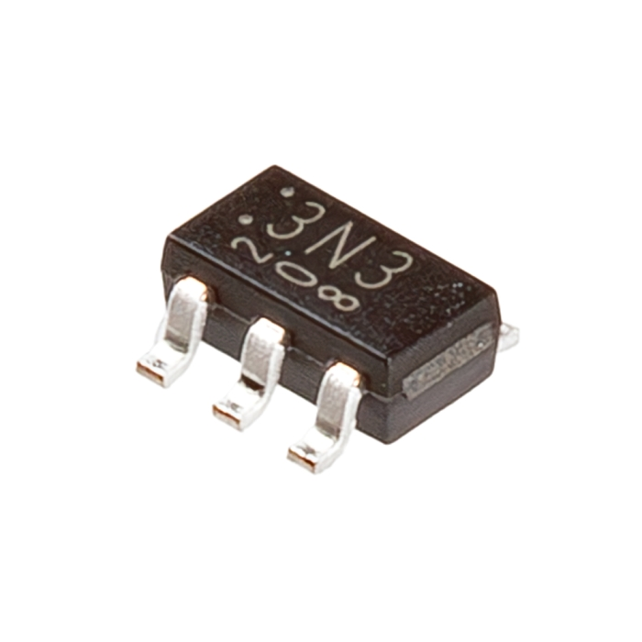
Nosie Reduction Strategies
There are two main ways to reduce noise:
Have a regulated precise Vref line
Add capacitors everywhere
I plan to use both strategies to help reduce the ADC noise.

Slide 5
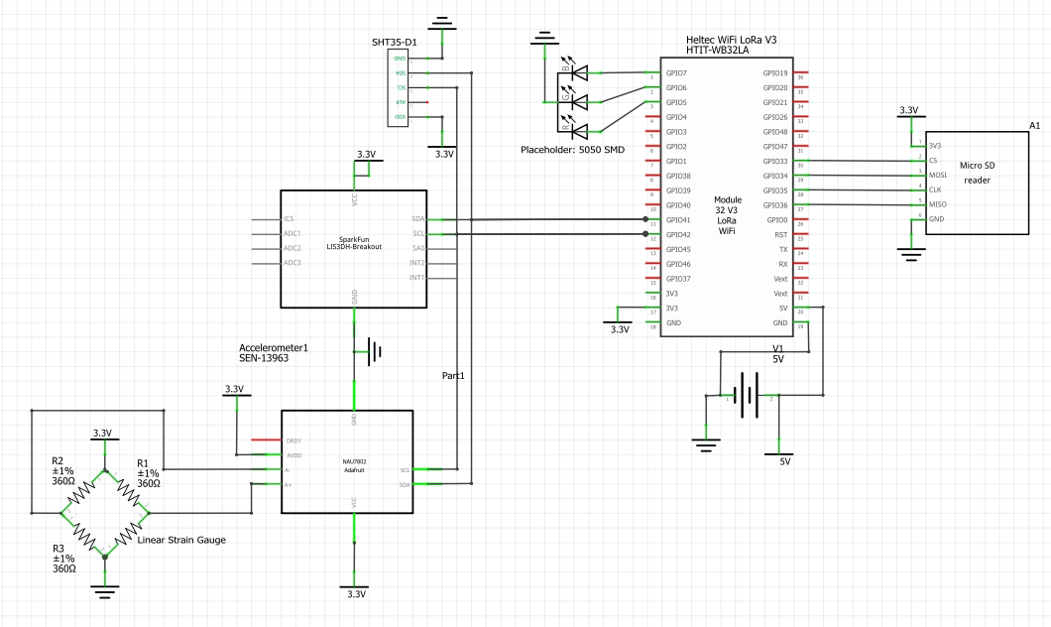
Electrical Schematic Updates
Updated System Schematic

Slide 6
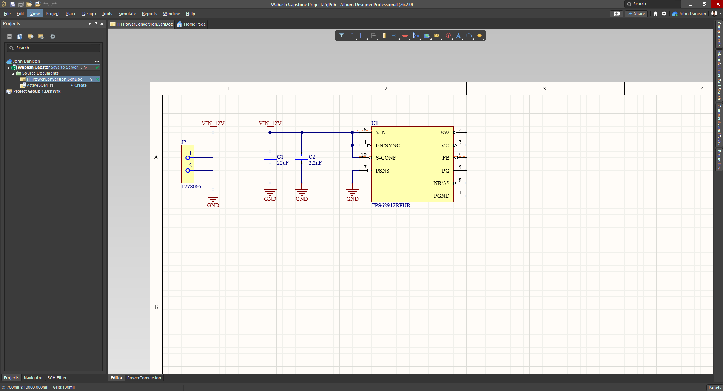

Electrical – Altium Designer
I started chipping away at the tall order of making the schematics in Altium.
The schematics are first needed before the PCB can be laid out

Slide 7
Did I Do What I Say I Would Do?
I believe that I covered everything that I said I would do. I started figuring out a solution to our noise issue. I also began development within Altium Designer.
I showed up to every lecture, lab, and meeting and contributed my knowledge with everyone.

Slide 8
Plans For Upcoming Weeks
High Level
By EOW:
Continue to refine system sensors & configuration.
Learn how to use Altium Designer. Will follow tutorial videos.
Continue to show up to class.
Continue to further refine the noise readings in strain gauge circuit. Begin testing researched solutions.
Continue creating schematics in Altium Designer.

